Slide 1
RFID Reader
Abraham Mendoza

Slide 2
Objectives
Create a RFID Reader that can distinguish between different tags
Give an output that will either grant access or deny it
Allow a user to register a RFID tag and be able to use it

Slide 3
Materials
Arduino Uno
LCD
RFID RC522 reader
Resistor
Potentiometer
Button
Wires

Slide 4
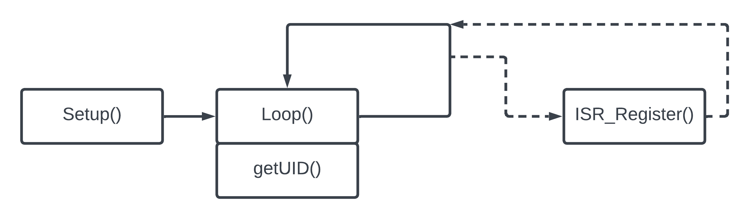
Diagram

Slide 5
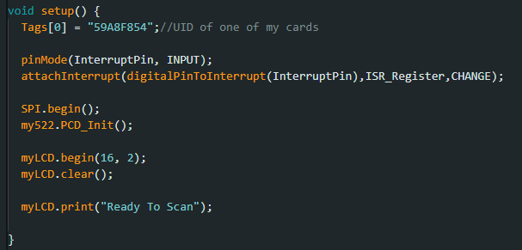
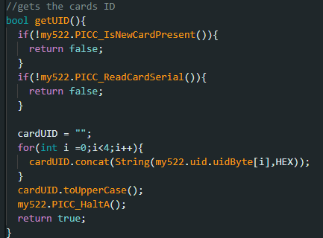
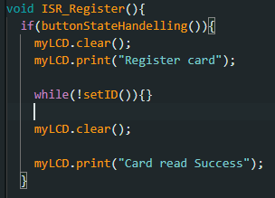
Code

Slide 6
Demo

Slide 7
Future Work
Save UID’s using EEPROM
Write to the RFID tags and read the data every time the tag is scanned
Create a Door locking mechanism that unlocks with the correct tag
Implement FreeRTOS

Slide 8
Thank You!

